Slide 1
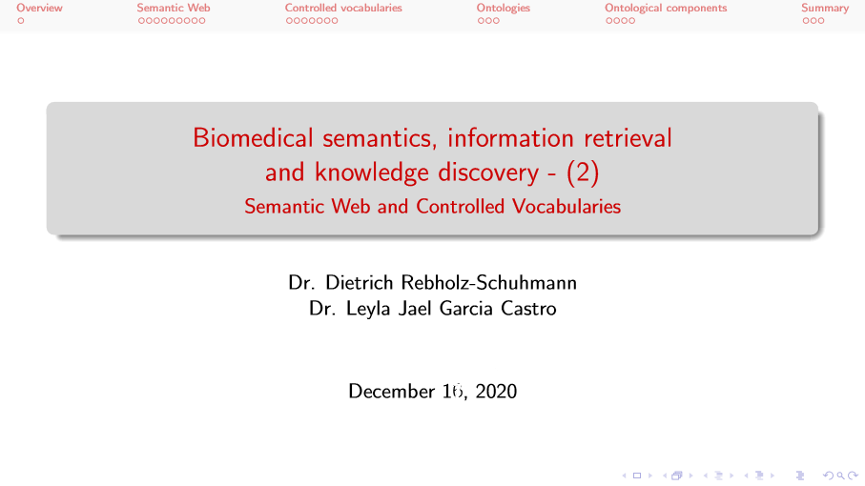

July, 2021

Slide 2
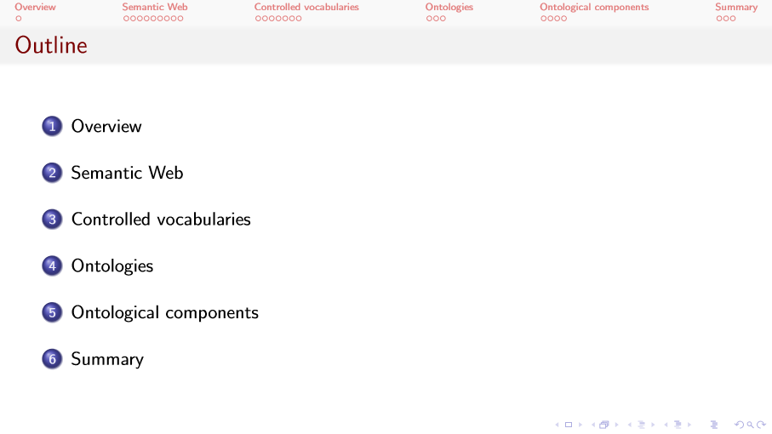

Slide 3
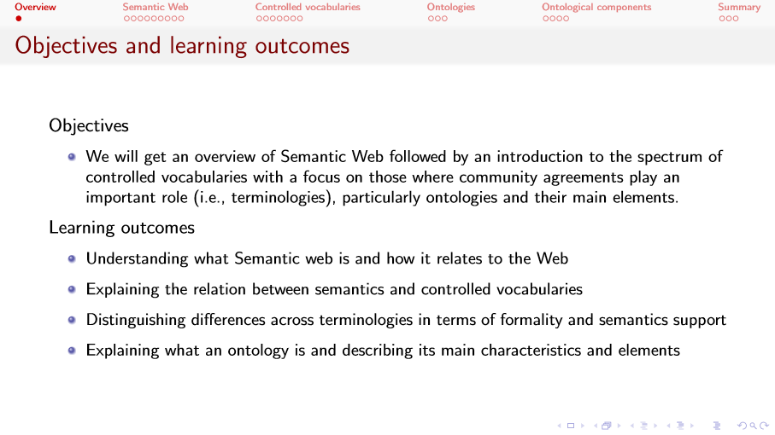
Notes:
So, how is the Web formed and what i happening in this WWW. When we are talking about WWW, we are mainly talking about com

Slide 4
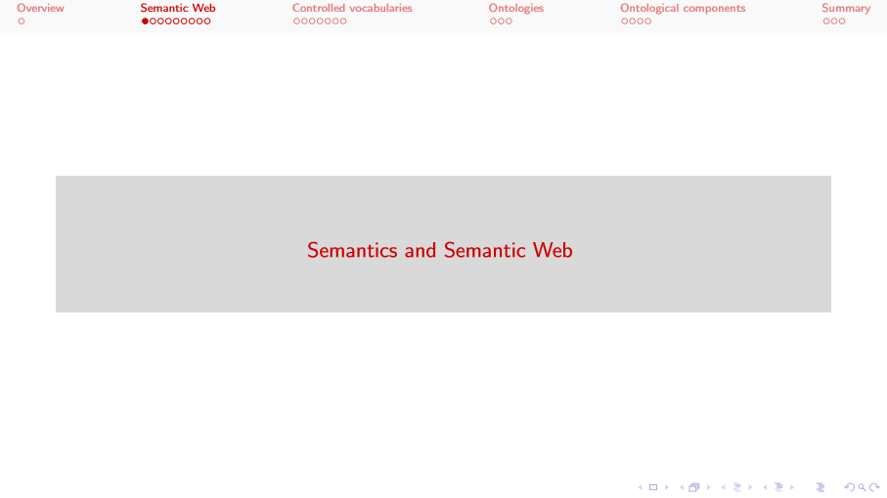

Slide 5
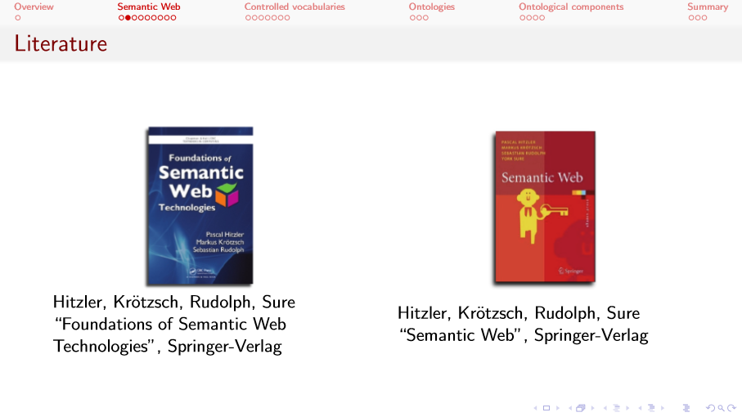

Slide 6
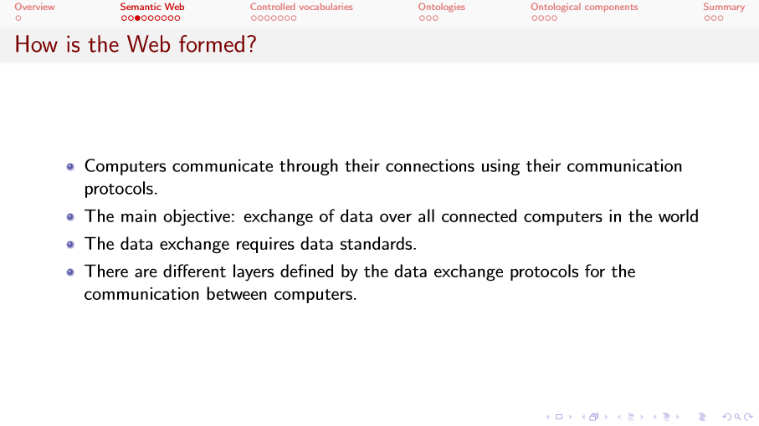
Notes:
So, how is the Web formed and what is happening in this WWW. Here, we are talking about computers connected with each other and communicating with each other.
The main objective here is exchanging data all over the connected computers in the world, this is one of the reasons it is called the World Wide Web.
For this data exchange to really happen, to be effective, we need data standards and also communication protocols.
And there are different layers that need to work together for this data exchange to happen. Some of these layers are related to communication protocols and to data standards
Thanks to them, we can really transmit one message from one computer to the other, making sure the message arrives as it was intended.

Slide 7
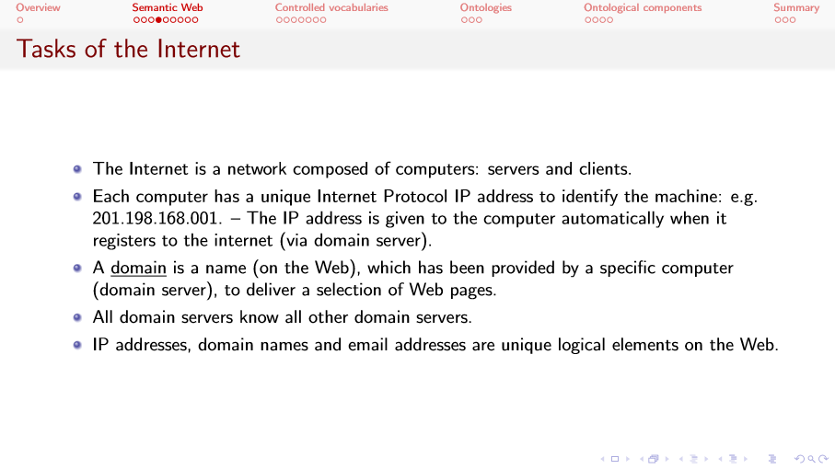

Slide 8
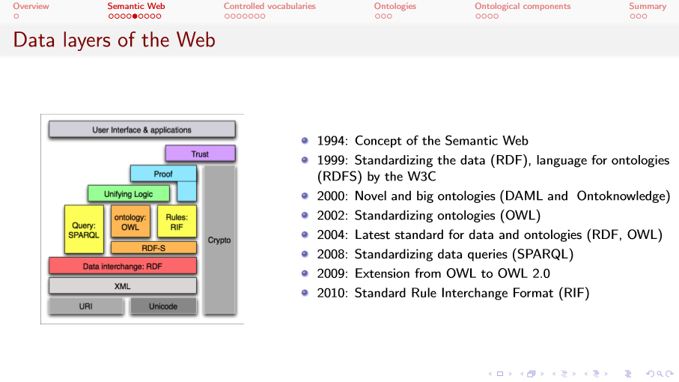
Notes:
Here we have some of the main data layers of the Web, some of them also part of the Semantic Web.
Here at the bottom we have some elements that are common to both Web and Semantic Web, while here in the middle, we have some elements that are particular to the Semantic Web.
Let’s also discuss some of the history of the Semantic Web.
Same as the Web, the Semantic Web was also conceived by Sir Tim Berners-Lee. The concept of the Semantic Web as we know it nowadays was defined in 1994
Although, the idea, the notion of a Semantic Network had been already discussed around the 60’s.
In 1999, the first version of the Resource Description Framework appeared. RDF, as it is know for short, aims at standardizing data on the Semantic Web.
That same year, we got also the RDF Schema, RDFs language, published by the W3C.
By the way, the W3C is the World Wide Web Consortium, an international community founded by Berners-Lee in 1994, working towards standards for the Web, some of them particularly targeting the Semantic Web.
In 2000, we had some further developments regarding ontologies with DAML and Ontoknowledge.
In 2002, we got the Web Ontology Language aka OWL, a language commonly used to model ontologies.
From then on, we got further developments on these already established technologies and languages.
We got new version for RDF and OWL in 2004, and very important in 2008, thanks to SPARQL, we got a way to query RDF data
Further versions and improvements are nowadays still on the go.
In recent years, Semantic technologies have been successfully combined with machine and deep learning approaches.

Slide 9
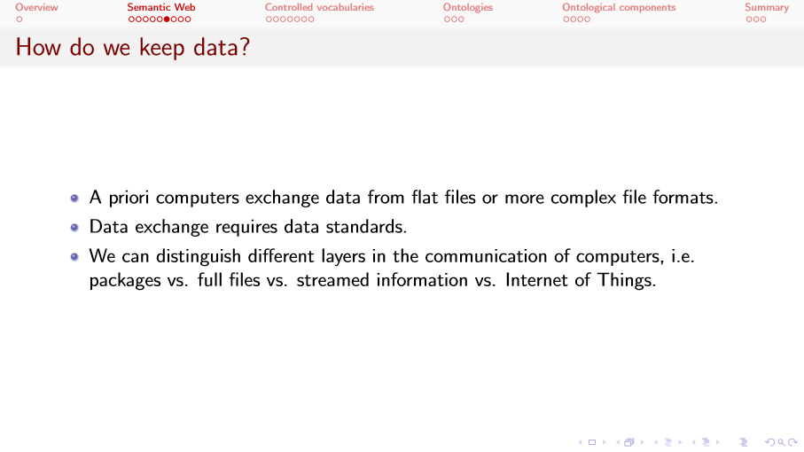

Slide 10
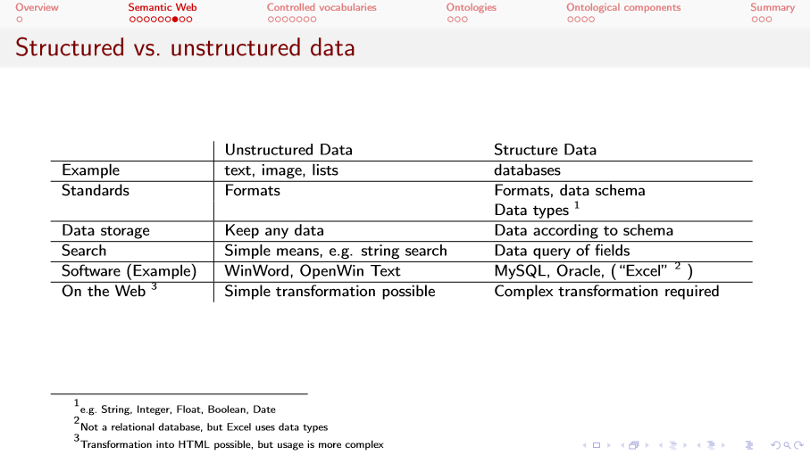

Slide 11
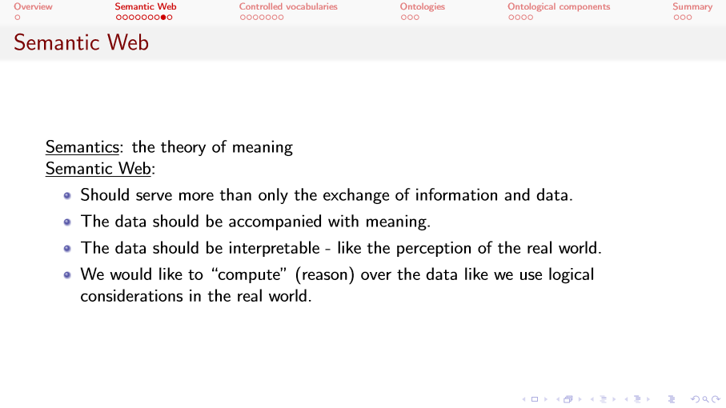

Slide 12
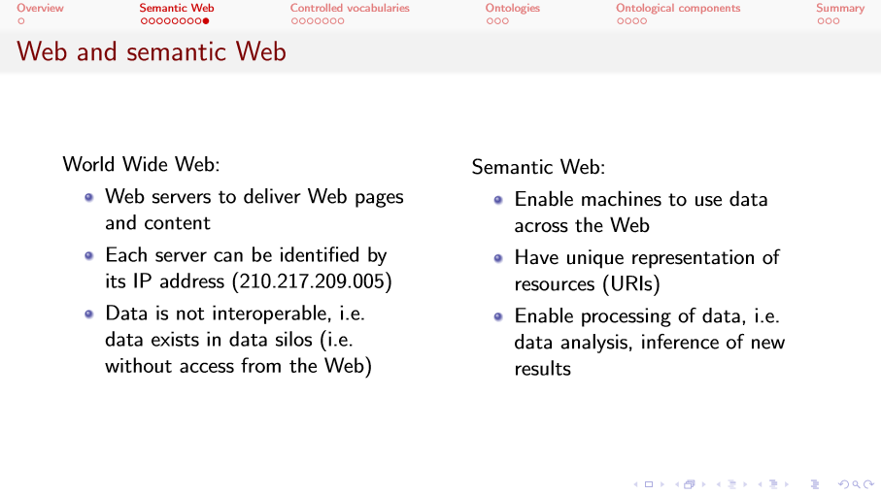

Slide 13
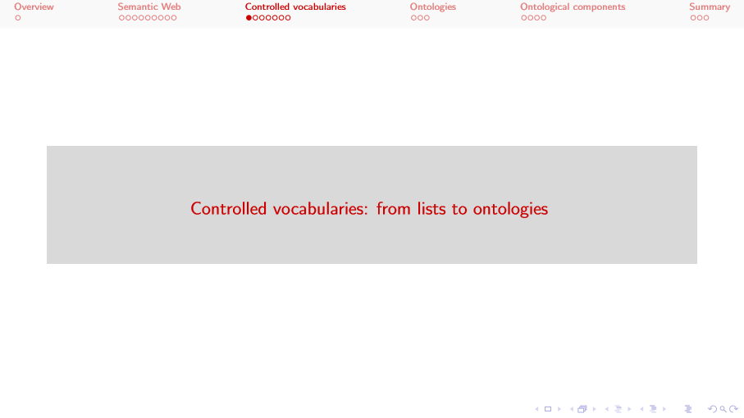

Slide 14
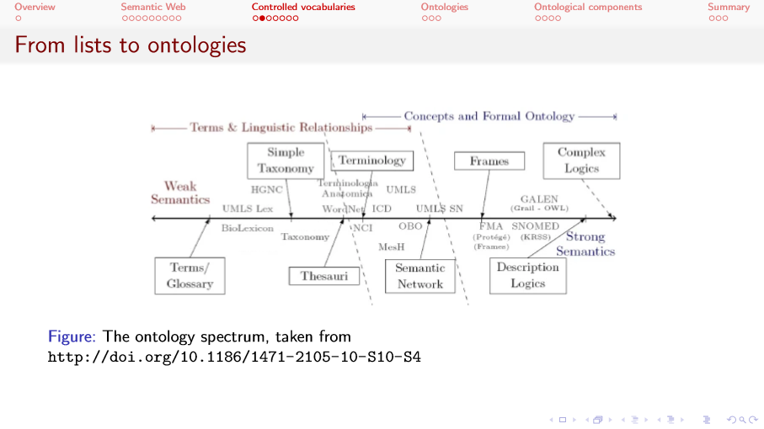
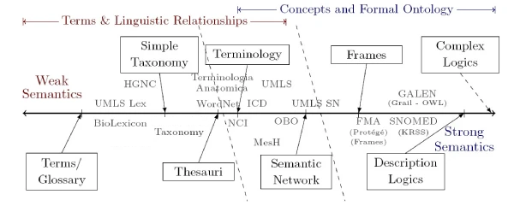

Slide 15
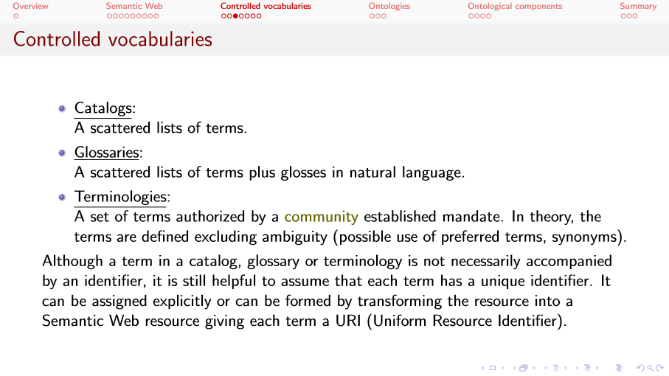

Slide 16
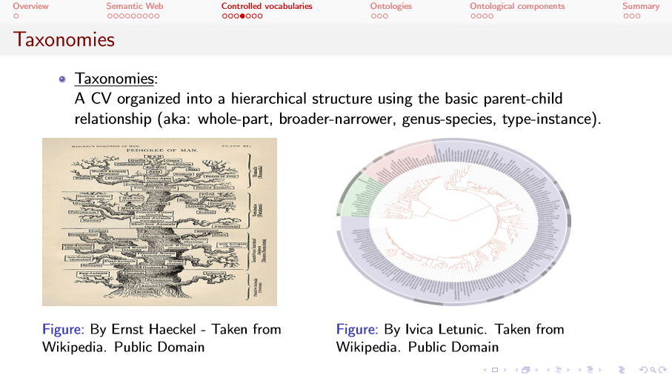
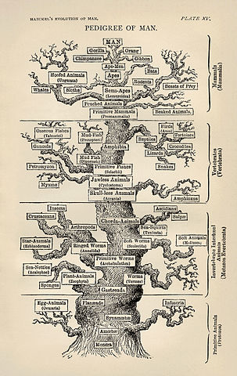
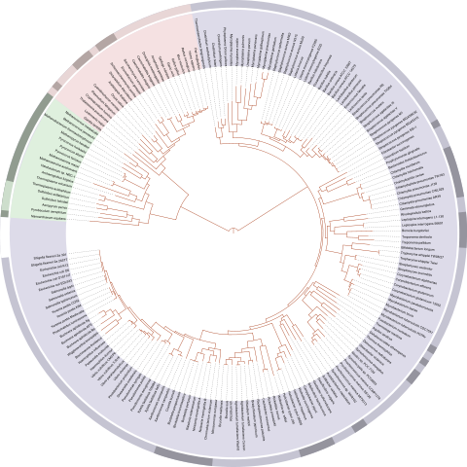

Slide 17
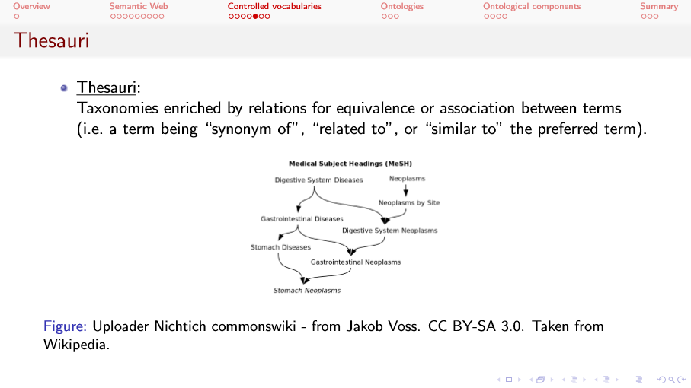
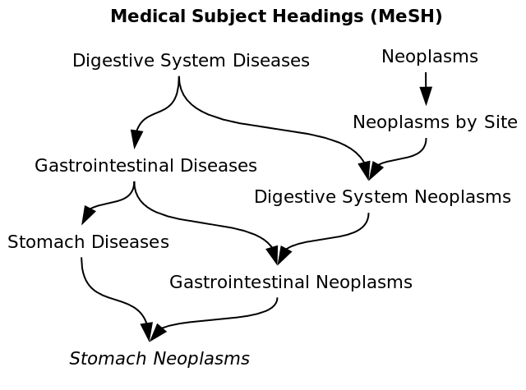

Slide 18
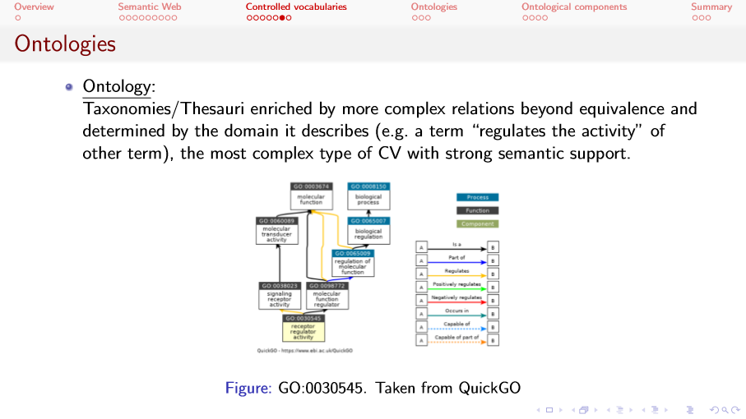
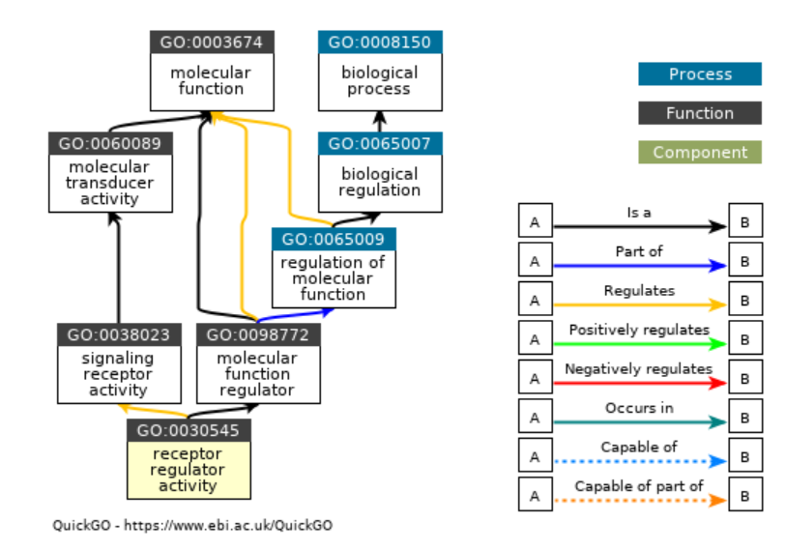

Slide 19
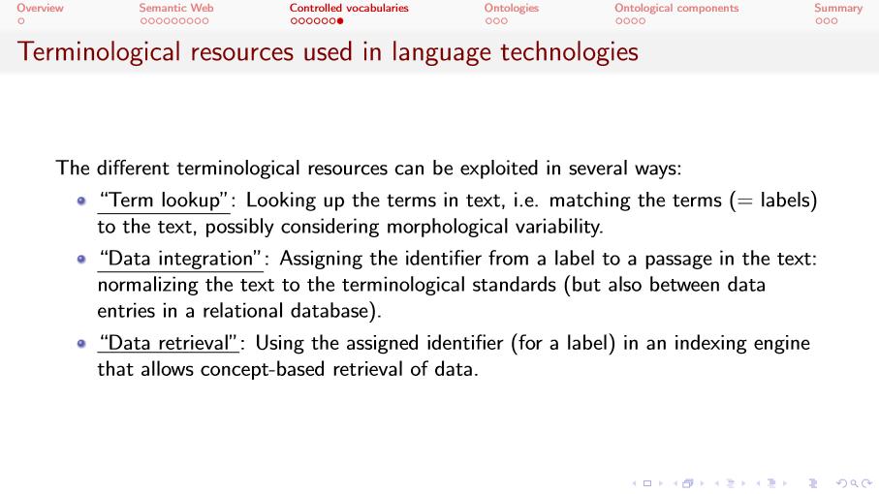

Slide 20
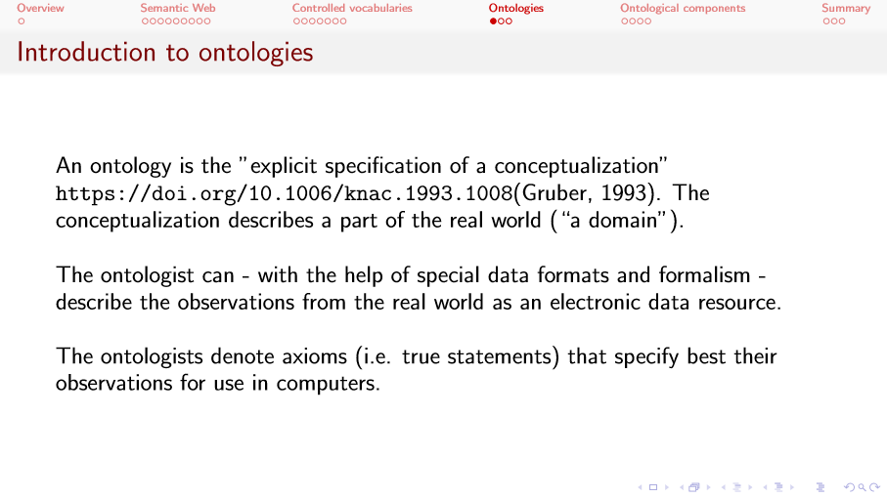

Slide 21
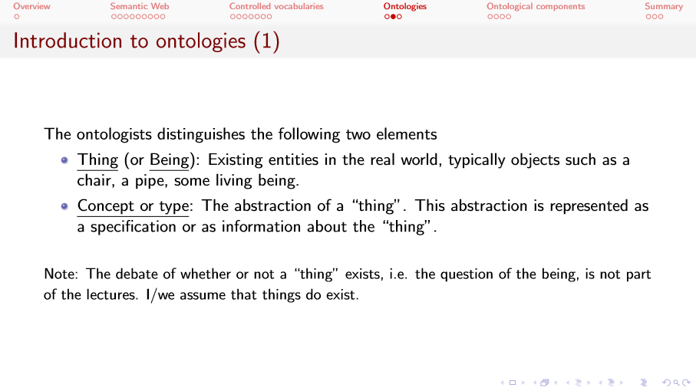

Slide 22
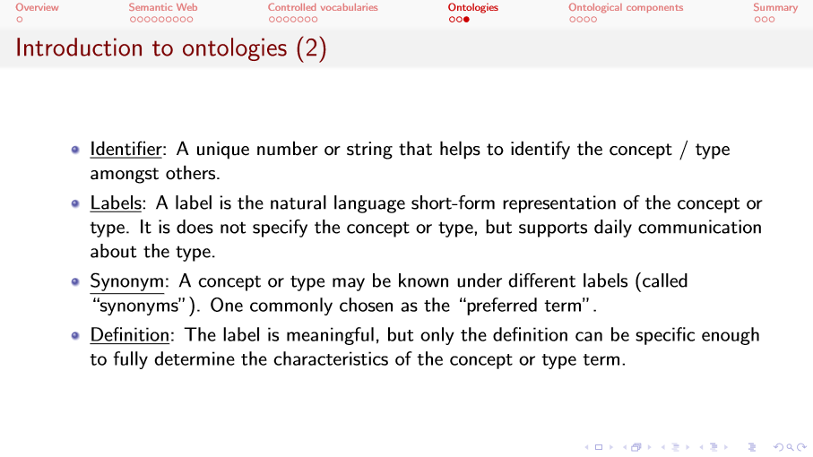

Slide 23
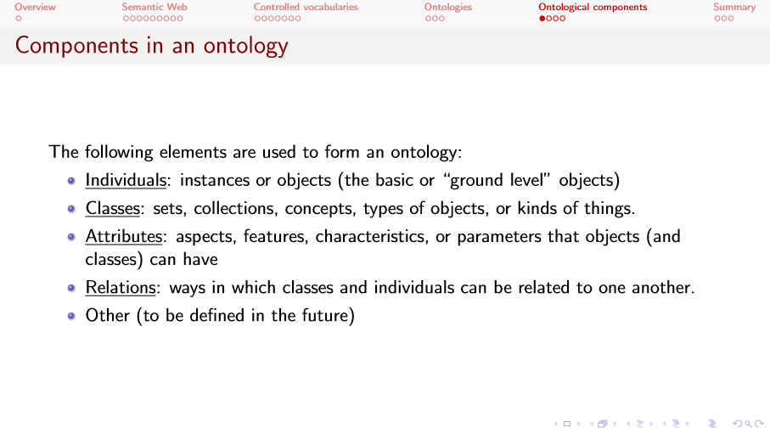

Slide 24
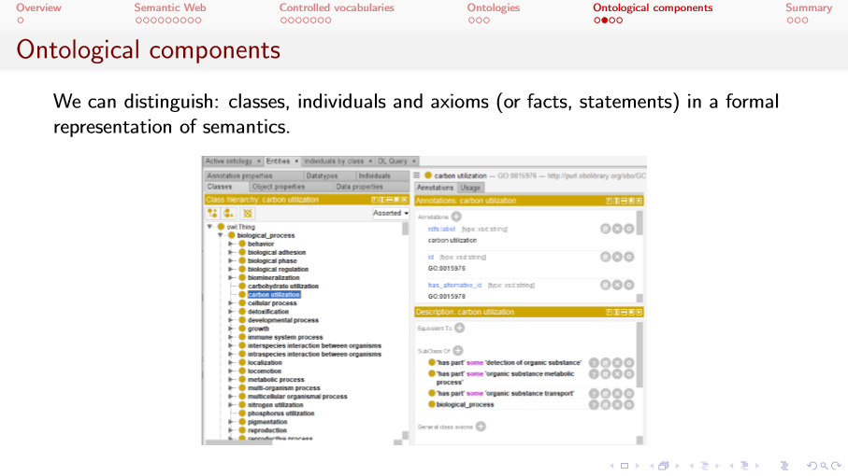
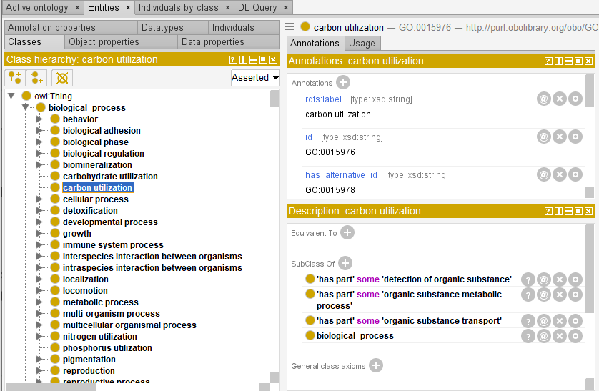

Slide 25
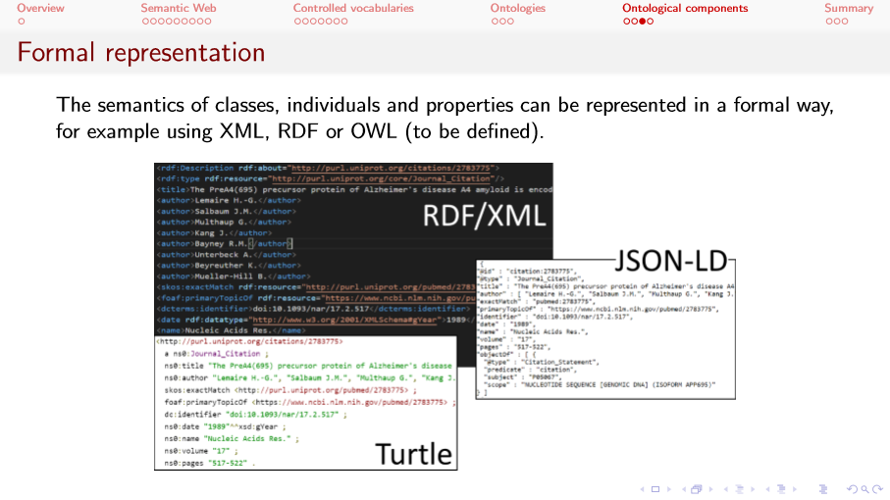
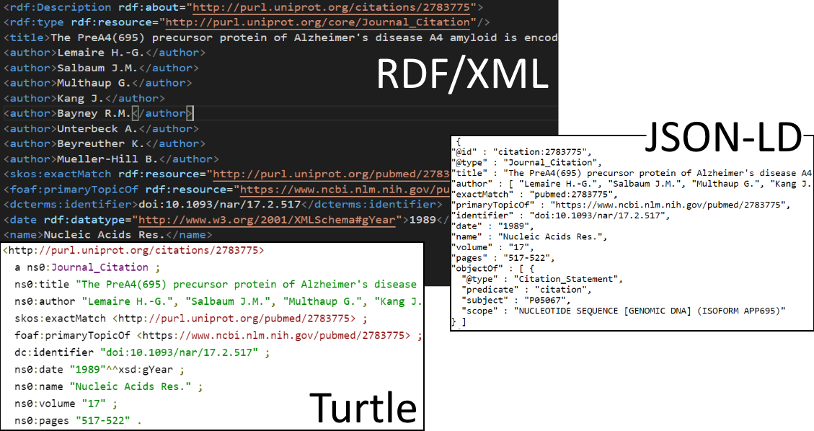

Slide 26
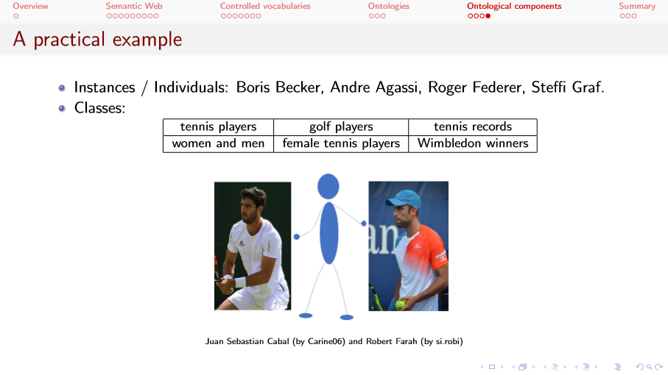

Slide 27
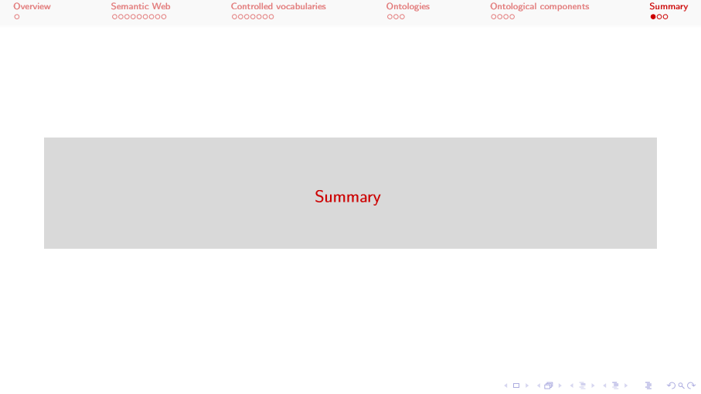

Slide 28
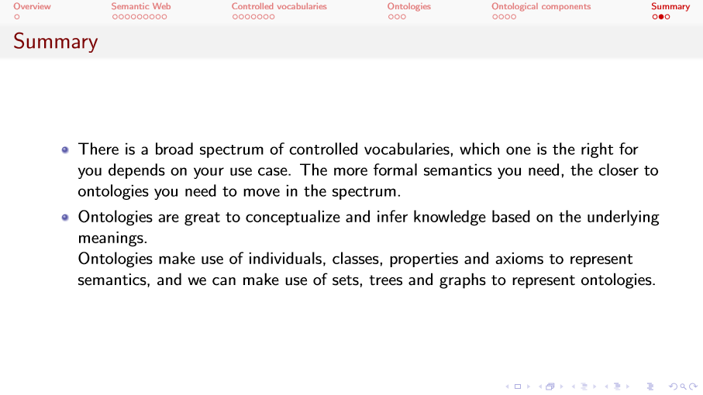

Slide 29
